Slide 1



uSpark
AI Medical Assistor
Sprint 1 Presentation
Team 1 – Rush Hour
CS691
March 2025

Slide 2

AGENDA
Team :
Roles and Responsibilities
Improvements
Project Overview:
Problem Statement
Project Description
Working Agreement
Personas
Product Design
MVP Design
Technology:
Technologies
Algorithms
Diagrams
Product Backlog
Sprint Backlog:
Backlog
Test Cases
Completed
Not Completed
Sprint 1 Metrics:
Velocity
Burndown Chart
Committed Ratio
Sprint 1 Retrospective
Sprint 2 Planning
Product Demo

Slide 3
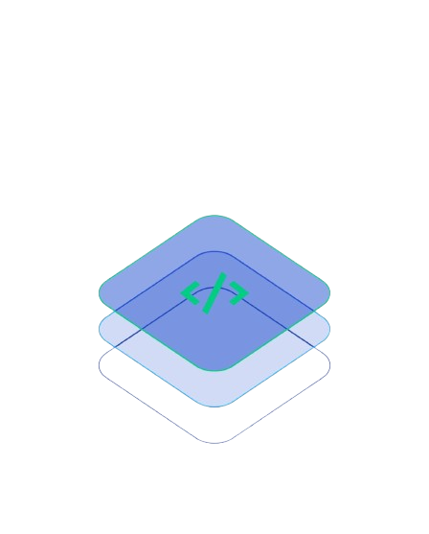
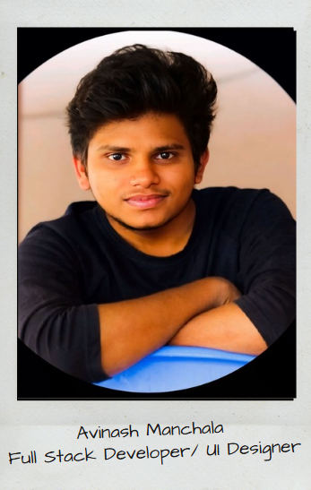
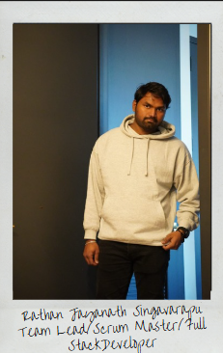
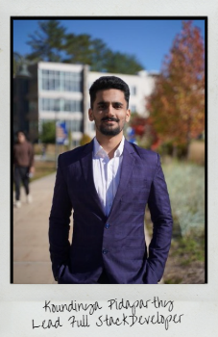
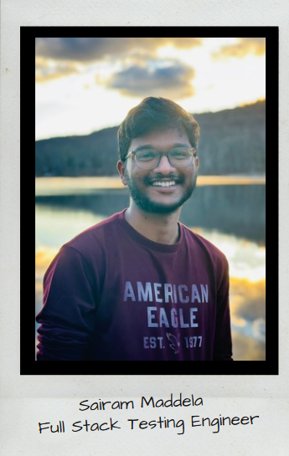
FULL STACK TEAM

Slide 4

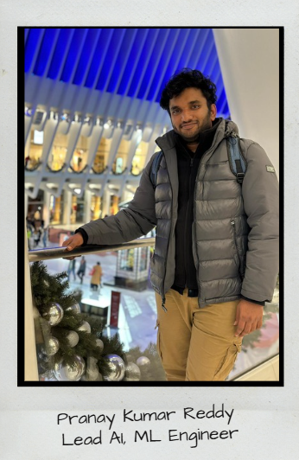
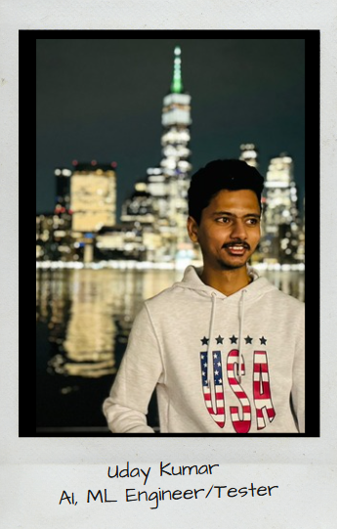
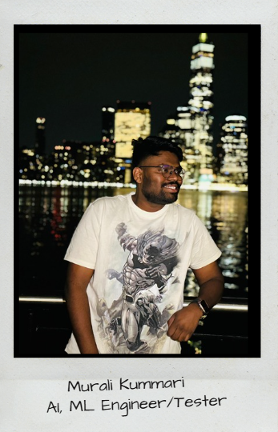
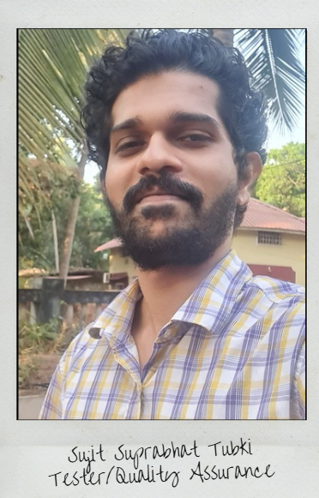
ML AI TEAM

Slide 5
Improvements from professor
Removed the Jira Screenshots
Made slides to communicate what needs to be delivered for each sprint

Slide 6
PROBLEM STATEMENT
Continuous Medical Assistance is one of a non-negotiable requirement these days and it can't be ignored. It is tedious to manage and store data related to a diagnosis of a patient for hospitals and for the patient as well. A simplified way of managing health care is needed, which can be achieved through AI chatbot and smart data storage system and like wise professionals in the medical sector can use a trained ML based algorithm service to reduce manual effort in the patient diagnosis.
This creates a hassle-free environment for both patient and doctors.

Slide 7
PROJECT DESCRIPTION
A robust approach to ease the process of health care and management with just one click!
➔“uSpark” is an Intelligent full stack application incorporated with machine learning that is an ultimate go-to point for the users/patients for all their healthcare related issues. uSpark allows users to schedule appointments in a hassle-free manner.
➔ These appointments can be virtual or in-person using “Uheal” a smart chatbot in the application that diagnoses the patient condition with the help of few questions. uSpark stores all the assessment details of the patient for further usage.
➔ Doctors can use uSpark as their personal virtual assistant that helps them in their work for managing appointments and patients records. It provides doctors with “Useg” a well-trained ML algorithm that precisely processes bio-medical images that produces an output

Slide 8

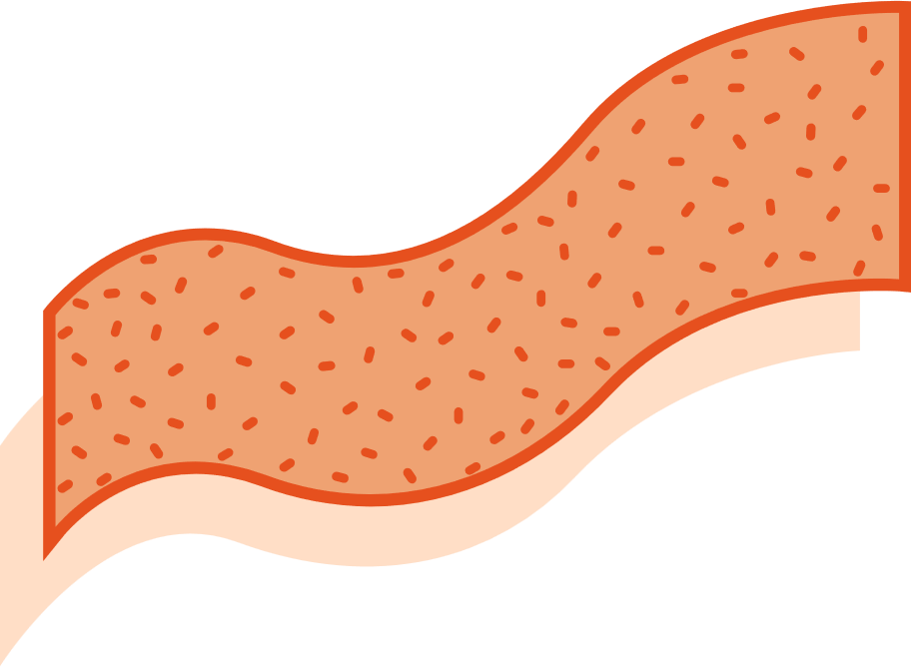




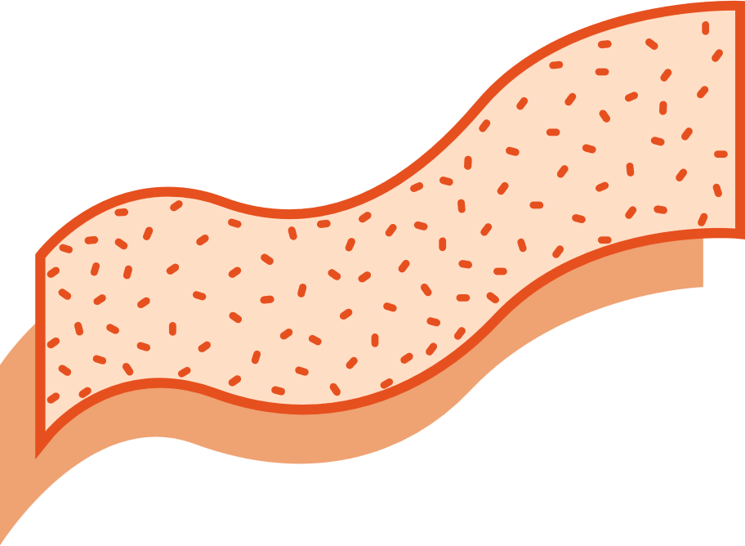



uSpark Application
FEATURE2
FEATURE 1
HOSPITAL RECOMMENDATIONS
Users can now see recommendations of hospitals that might be suitable for their issue. These recommendations on their assessment done via a series of questions asked by our chatbot “Uheal”
Distance from Hospital, working hours can be seen.
BOOK APPOINTMENTS!!
uSpark allows users to make appointments which can be in-person or virtual based on their availability and doctor’s availability , in contrast to the traditional way of making appointments
FEATURE 4
ONE CARD
FEATURE 3
uHeal stores the details of the health issue of the patient which is obtained from the conducted assessment, all the assessment details are saved on ONE CARD along with the date of assessment. One card involves patient’s assessment details, insurance details, personal details and a QR code that is used to share the ONE CARD, this completely eliminates the need for physical documents to store information.
CHATBOT – Uheal
uHeal conducts assessment for the patients with the help of series of questions and also gives few preventive measures and also it makes appointments for the user by giving recommendations about hospitals, in contrast to traditional method of searching hospitals
FEATURE 5: Useg
Useg is an ML algorithm that is used by doctors as a part of their diagnosis.
This makes their work easier and helps them to narrow down the issue in a much quicker way

Slide 9
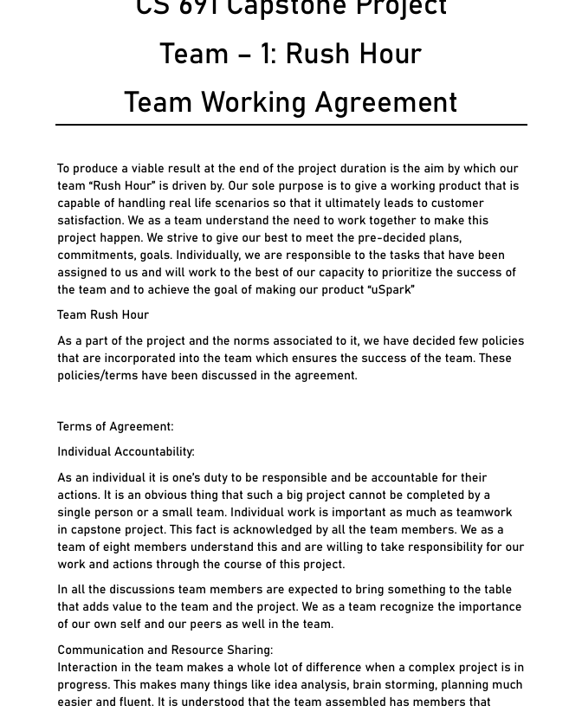
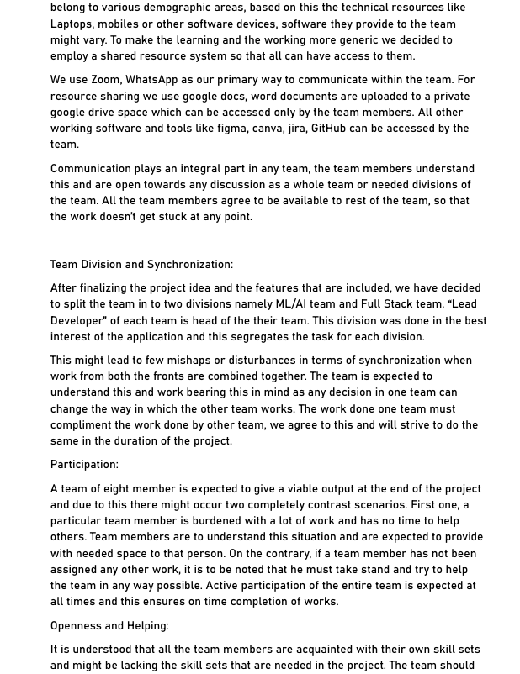
Team Working Agreement
Link:
Team working agreement
1

Slide 10
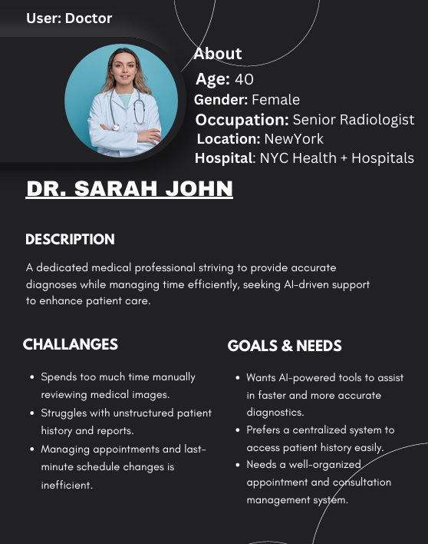
Persona 1
1

Slide 11
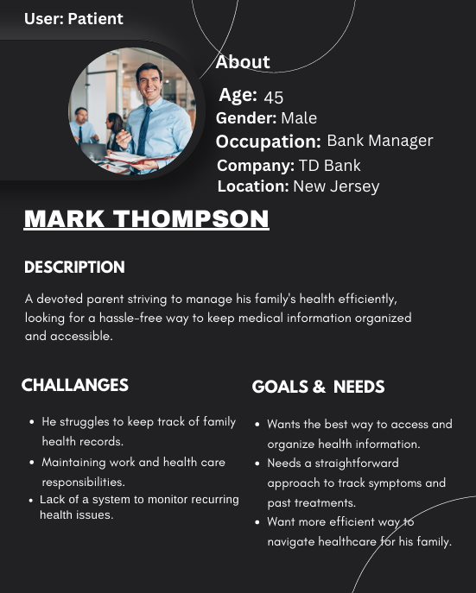
Persona 2
1

Slide 12
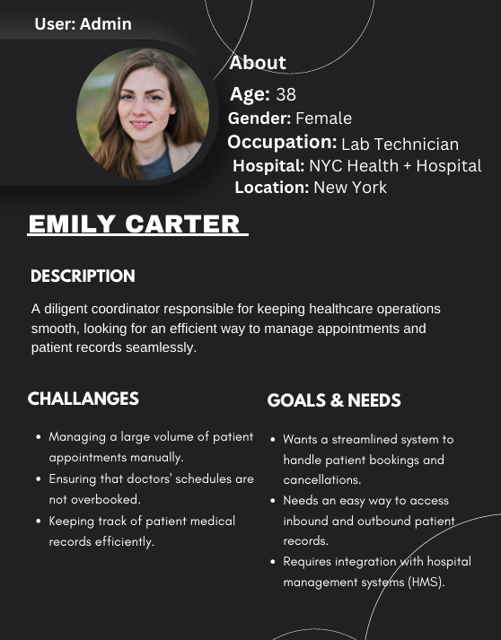
Persona 3
1

Slide 13
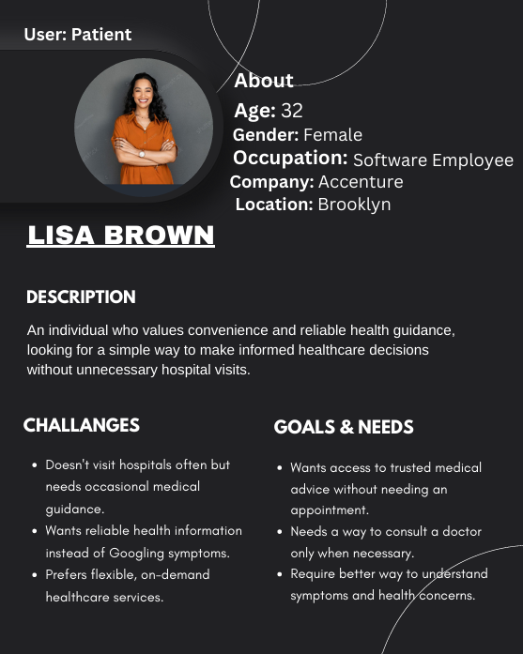
Persona 4
1

Slide 14
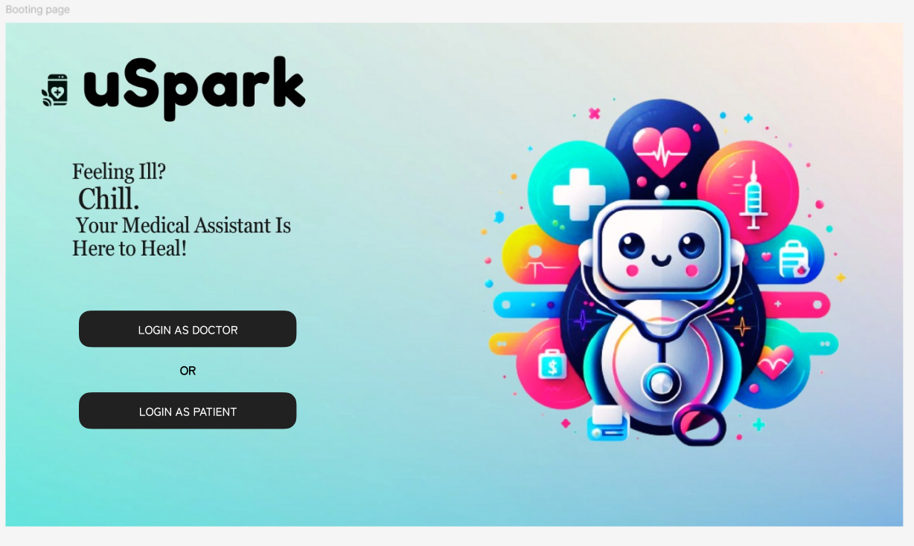
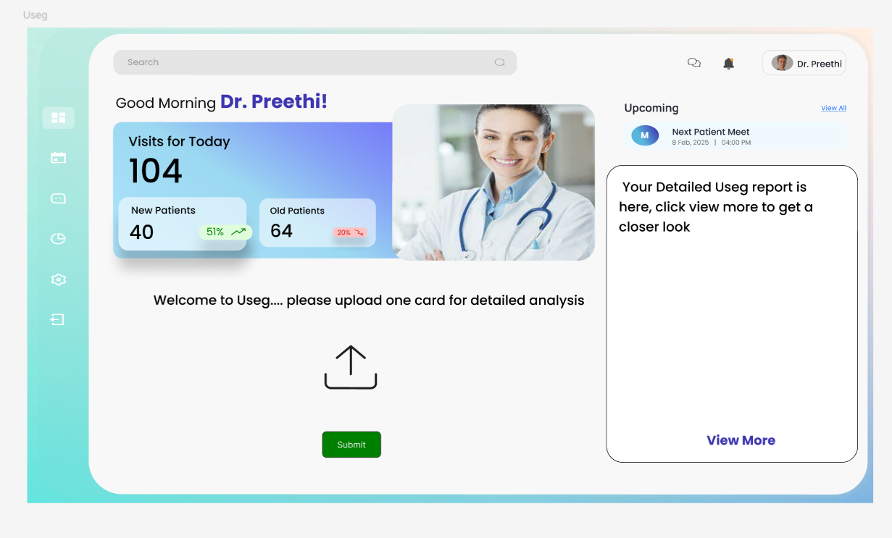
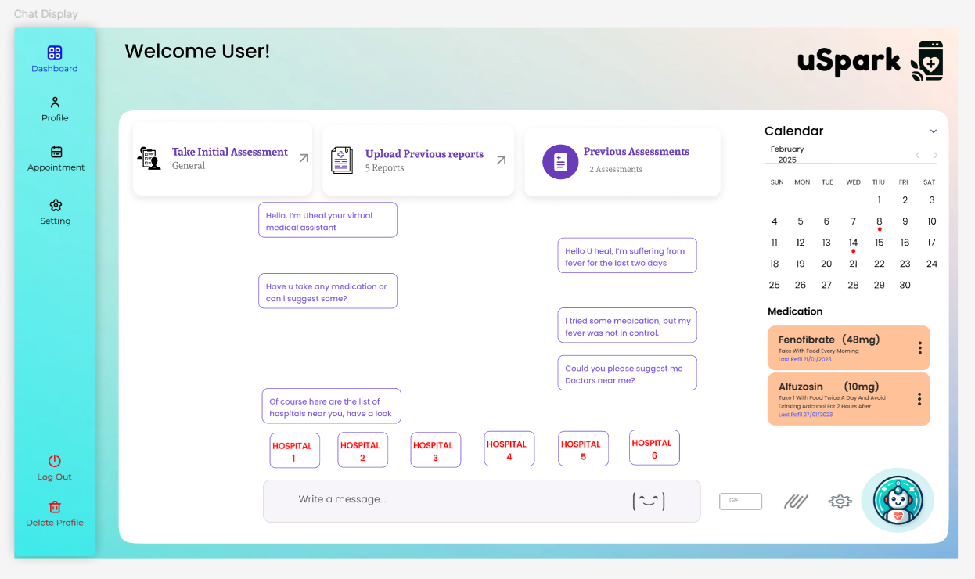
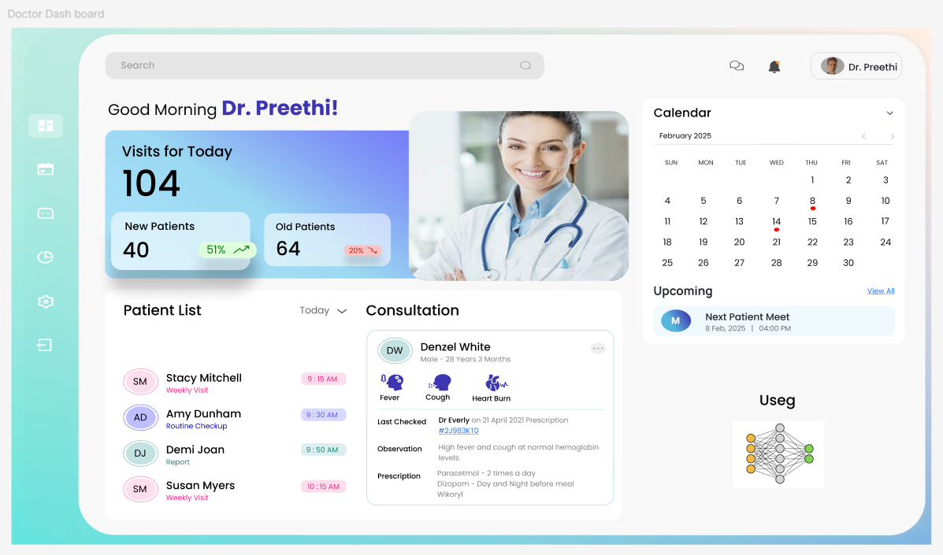
Product Design

Slide 15
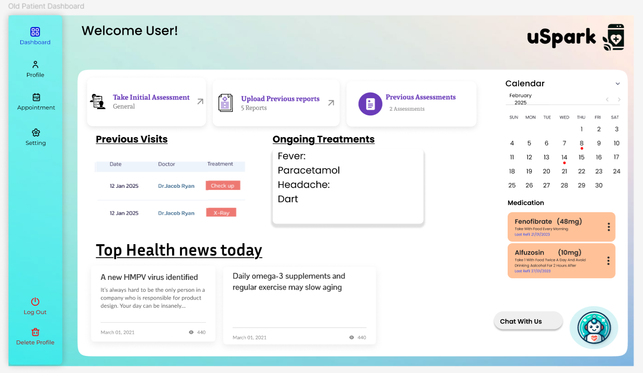
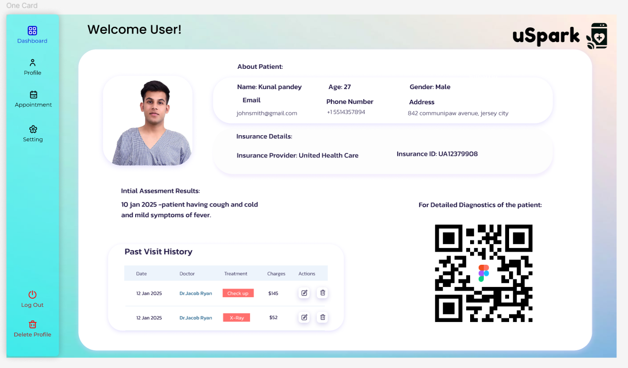
MVP Design

Slide 16









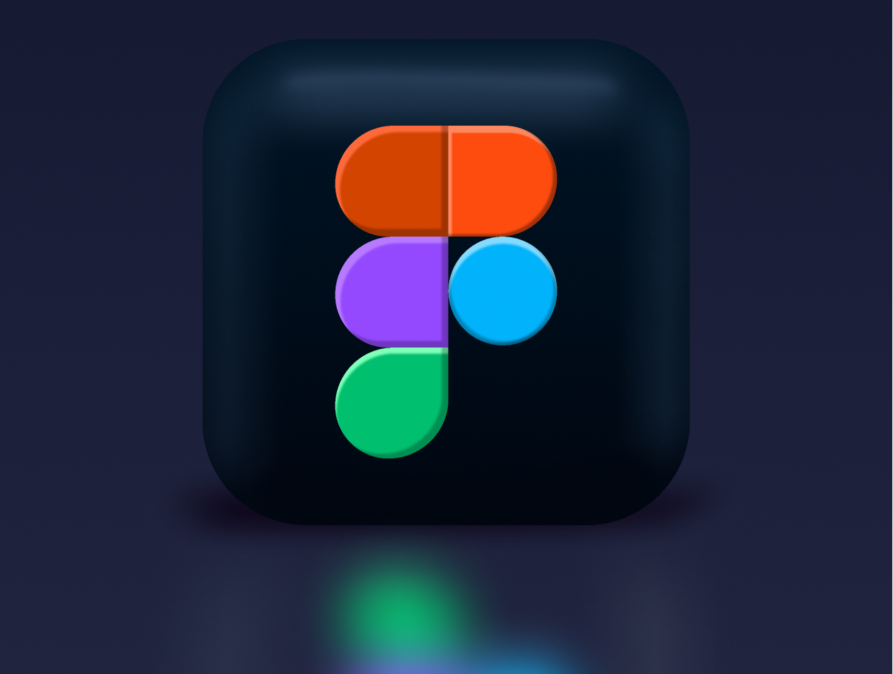









Technologies and Tools
Mongo DB
Amazon S3
Jira
Docker
Node JS
React
Python
Faiss Vector Database
Figma
MERN Stack
VS code
Redux
Axios
Material UI
Pytorch
TensorFlow
Flask
GitHub
Postman
Full Stack /ML AI Programming Languages
Libraries, Algorithms and Frameworks, Database
Tools

Slide 17
Algorithms And Models:
Rag - Retrieval-Augmented Generation
Densnet
Resnet
DialoGPT

Slide 18
Diagrams

Slide 19
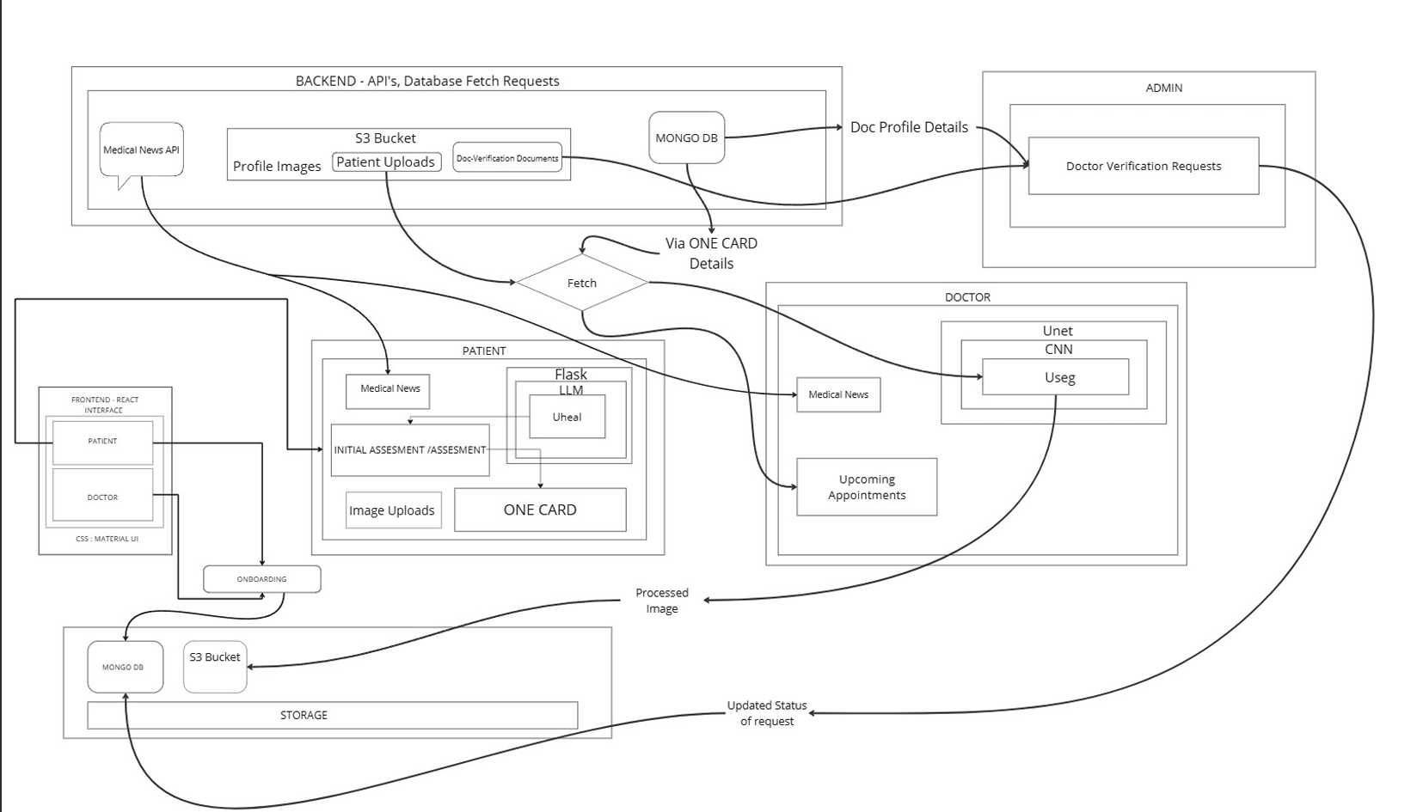
Architecture Diagram

Slide 20
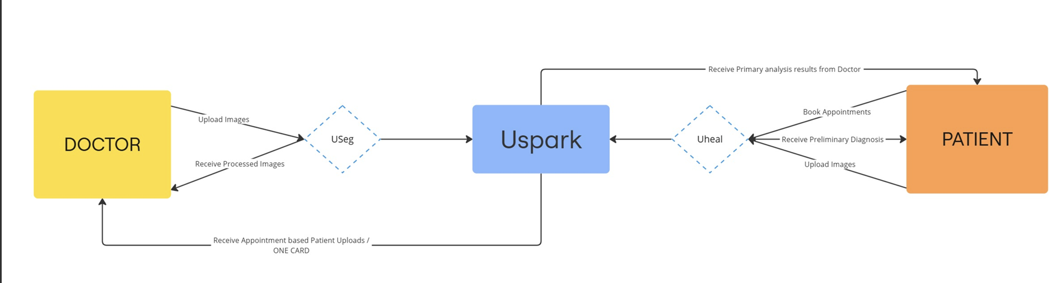
Context Diagram

Slide 21
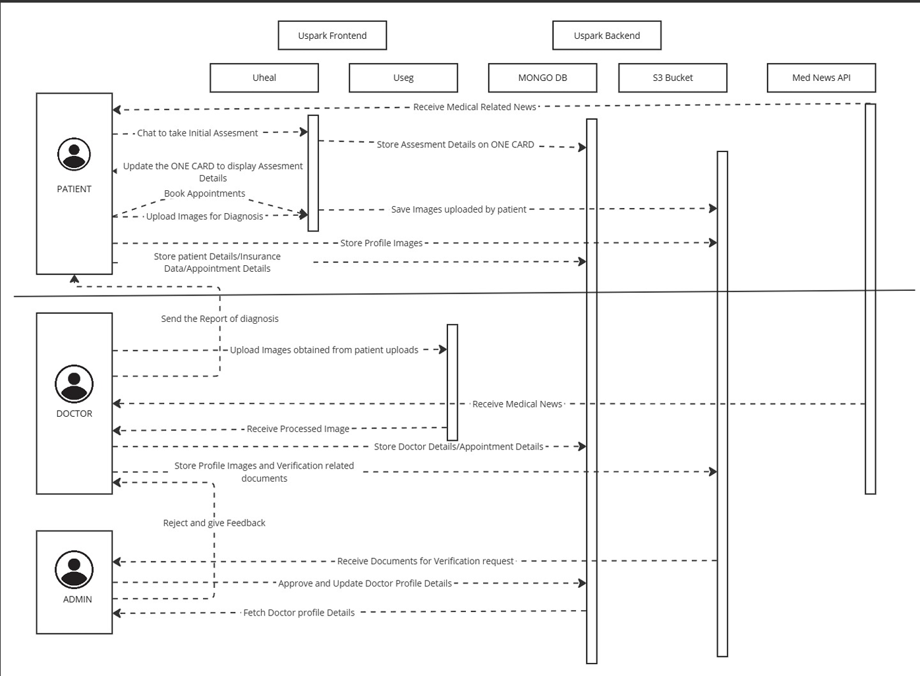
Sequence Diagram

Slide 22
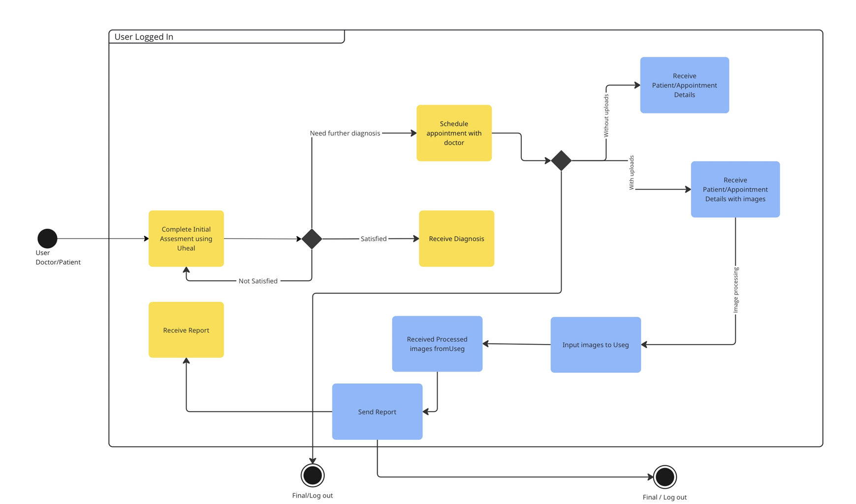
State Diagram

Slide 23
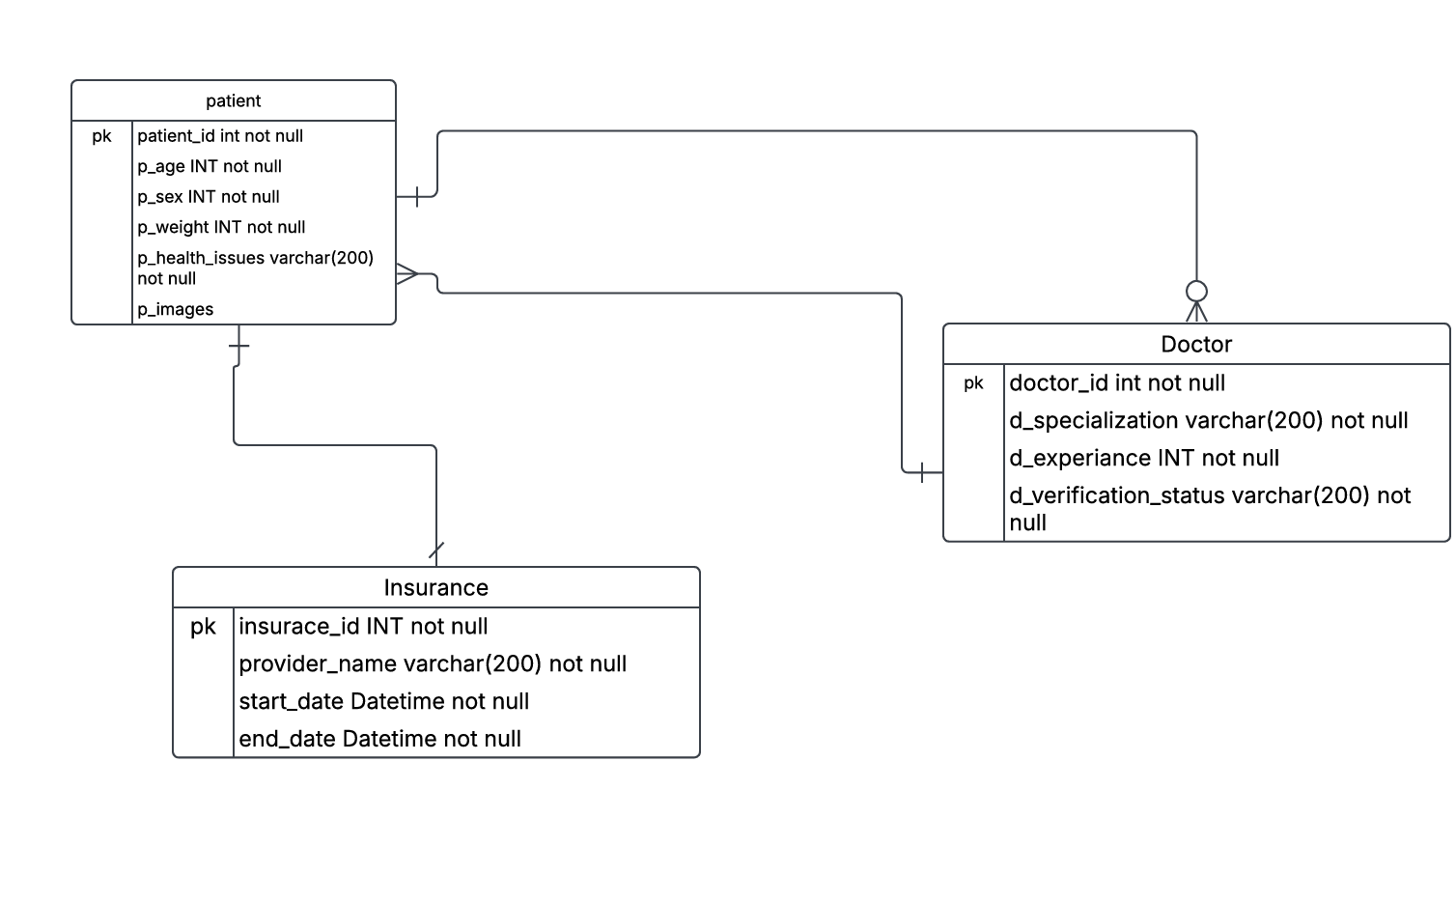
Class Diagram

Slide 24
Product Backlog
S.NO | USER STORIES | ACCEPTANCE CRITERIA | FEATURE | STORY POINTS
US_1 | As a patient, I want to sign up using email, phone, or social media so that I can access the application. | Given a patient accesses the signup page, When they enter valid credentials (email, phone, or social media), Then they should successfully create an account and log in. | Patient sign-up via email, phone, or social media | 3
US_2 | As a patient, I want to reset my password in case I forget it. | Given a patient clicks on "Forgot Password," when they enter a registered email or phone, then they should receive a reset link or OTP. | Password reset functionality
US_3 | As a patient, I want to create and update my profile with personal details, and insurance information. | Given a patient is logged in, when they update personal, medical, or insurance details, then the changes should be saved. | Patient profile management
US_4 | As a patient, I want to view my past appointments and prescriptions in my profile. | Given a patient accesses their profile, when they navigate to "Appointments" or "Prescriptions," then they should see a history of their records. | View past appointments & prescriptions
US_5 | As a patient, I want to store my past medical assessments and reports for future reference. | Given a patient uploads a report, when the file is successfully processed, then it should be saved securely | Upload & store medical assessments and reports
US_6 | As a patient, I want to share my medical history with doctors for better diagnosis. | Given a patient selects a doctor, when they choose to share medical history, then the doctor should be granted access. | Share medical history with doctors
US_7 | As a patient, I want to schedule an appointment with a doctor based on available time slots. | Given a patient search for a doctor, when they select a time slot and confirm, then the appointment should be booked. | Appointment scheduling via Uheal.
US_8 | As a patient, I want to choose between virtual or in-person appointments. | Given a patient is booking an appointment, when they select "Virtual" or "In-Person," then the system should confirm their choice. | Choose virtual or in-person consultation via Uheal.

Slide 25
US_9 | As a patient, I want to receive appointment confirmation via email or SMS. | Given a patient books an appointment, when it is confirmed, then they should receive an email or SMS notification. | Appointment confirmation via email/SMS via Uheal.
US_10 | As a patient, I want to reschedule or cancel an appointment. | Given a patient has an appointment, when they request to reschedule or cancel, then the system should update accordingly. | Reschedule or cancel appointments via Uheal.
US_11 | As a patient, I want to search for doctors based on specialty, availability, and location. | Given a patient is on the search page, when they filter by criteria, then only matching doctors should be displayed. | Search doctors based on specialty, availability, and location via Uheal.
US_12 | As a patient, I want to see ratings and reviews for doctors before booking an appointment | Given a patient views a doctor’s profile, when reviews exist, then they should be displayed. | View doctor ratings and reviews via Uheal.
US_13 | As a patient, I want to receive a preliminary diagnosis from application based on my symptoms. | Given a patient interacts with the chatbot, when they provide symptoms, then the chatbot should generate a preliminary diagnosis. | AI-based preliminary diagnosis via Uheal.
US_14 | As a patient, I want suggestions whether I need an in-person visit, virtual consultation, or self-care. | Given a patient enters symptoms, when the AI assesses them, then it should suggest self-care, virtual, or in-person visits. | AI-based consultation suggestions via Uheal.
US_15 | As a patient, I want to join a video call for virtual consultations | Given a patient has a virtual appointment, when they click "Join Call," then they should be connected. | Video call for virtual consultations via Uheal.
US_16 | As a patient, I want recommend doctors based on my condition. | Given a patient provides symptoms, when AI processes the data, then it should recommend the best doctor. | AI doctor recommendations based on condition.

Slide 26
US_17 | As a patient, I want to link my health insurance to cover consultation charges. | Given a patient has insurance, when they enter valid details, then the system should verify and apply coverage. | Link health insurance for payment coverage | 5
US_18 | As a doctor, I want to register and submit my credentials for verification. | Given a doctor registers, when they submit credentials, then the system should send it for admin approval. | Doctor registration and Onboarding | 5
US_19 | As a doctor, I want to login to my profile, and view my details | Given a doctor logs in, they should be directed to their dashboard and should be able to view their profile details. | Doctor profile management | 3
US_20 | As a doctor, I want to see a list of my upcoming and past appointments. | Given a doctor is on the dashboard, when they check "Appointments," then they should see scheduled consultations. | Appointment Management
US_21 | As a doctor, I want to manage my patients' health records and notes. | Given a doctor accesses a patient profile, when they add or update notes, then the system should store the data securely. | Manage patient health records and notes can be done with one card
US_21 | As a doctor, I want to upload medical images (X-rays, MRIs, CT scans) for AI processing. | Given a doctor uploads an image, when AI processes it, then results should be displayed. | Upload medical images (X-rays, MRIs, CT scans) for AI processing via Useg.
US_22 | As a doctor, I want to get heat maps and segmented outputs for easier diagnosis. | Given an image is processed, when AI detects anomalies, then the doctor should receive a heatmap/segmentation output. | AI-based heat maps & segmented output via Useg. | 8
US_23 | As a doctor, I want to get potential diagnoses based on biomedical images. | Given a doctor uploads an image, when AI evaluates it, then the system should provide diagnostic insights. | AI-generated potential diagnosis based on biomedical images via Useg.
US_24 | As a doctor, I want to receive notifications when a patient books or cancels an appointment. | Given a patient books or cancels, when the status changes, then the doctor should receive a notification. | Receive notifications for appointments
US_25 | As an admin, I want to manage and verify doctors’ credentials before they are approved. | Given a doctor submits credentials, when the admin reviews them, then they should be able to approve or reject the request. | Manage doctor verification & approval via Admin dashboard. | 5
US_26 | As an admin, my dashboard needs access by me only not by others for security purposes. | Given an admin only accesses the dashboard, when they check logs, then they should see activity reports. | Monitor system activity & security | 5

Slide 27
SPRINT 1 STORIES
S.NO | USER STORIES | ACCEPTANCE CRITERIA | FEATURE | STORY POINTS
US_01 | As a patient, I want to sign up using email, phone, or social media so that I can access the application. | Given a patient accesses the signup page, When they enter valid credentials (email, phone, or social media), Then they should successfully create an account and log in. | Patient sign-up via email, phone, or social media | 3
US_03 | As a patient, I want to create and update my profile with personal details and insurance information. | Given a patient is logged in, when they update personal, medical, or insurance details, then the changes should be saved. | Patient profile management | 4
US_18 | As a doctor, I want to register and submit my credentials for verification. | Given a doctor registers, when they submit credentials, then the system should send it for admin approval. | Doctor registration and Onboarding | 5
US_22 | As a doctor, I want to get heat maps and segmented outputs for easier diagnosis. | Given an image is processed, when AI detects anomalies, then the doctor should receive a heatmap/segmentation output. | AI-based heat maps & segmented output via Useg. | 8
US_25 | As an admin, I want to manage and verify doctors’ credentials before they are approved. | Given a doctor submits credentials, when the admin reviews them, then they should be able to approve or reject the request. | Manage doctor verification & approval via Admin dashboard. | 5
US_19 | As a doctor, I want to login to my profile, and view my details | Given a doctor logs in, they should be directed to their dashboard and should be able to view their profile details. | Doctor profile management | 3

Slide 28
SPRINT 1 TEST CASES
US_19: As a doctor, I want to login to my profile, and view my details.
.
TC | Test Case | Steps | Expected Result | Status | Execution date | Tester
TC_19_01 | Load Login Page | 1. Navigate to /login 2. Check if the login page loads successfully | Login page should be displayed with all necessary elements visible | Pass | Feb-20 | Uday
TC_19_02 | Invalid Login | 1. Enter an incorrect email and password 2. Click the login button | An error message should be displayed indicating incorrect credentials | Pass | Feb-20 | Uday
TC_19_03 | Valid Login | 1. Enter a valid email and password 2. Click the login button 3. Wait for authentication and redirection | User should be successfully logged in and redirected to the onboarding page or dashboard | Pass | Feb-20 | Uday

Slide 29
Us_01 As a patient, I want to sign up using email, phone, or social media so that I can access the application.
TC | Test Case | Steps | Expected Result | Status | Execution date | Tester
TC_01_01 | Load Signup Page | 1. Navigate to /signup 2. Check if the signup page loads successfully | Signup page should be displayed with all necessary elements visible | Pass | Feb-22 | Sairam
TC_01_02 | Password Mismatch | 1. Enter a valid name and email 2. Enter two different passwords 3. Click the signup button | An error message should be displayed indicating that passwords do not match | Pass | Feb-22 | Sairam
TC_01_03 | Successful Signup | 1. Enter a valid name, email, and matching passwords 2. Click the signup button 3. Wait for redirection | User should be successfully registered and redirected to the onboarding page | Pass | Feb-22 | Sairam
TC_01_04 | Required Fields | 1. Click the signup button without entering any details | Error messages should be displayed indicating that all fields are required | Pass | Feb-22 | Sairam
TC_01_05 | Google Signup | 1. Click the 'Sign up with Google' button 2. Wait for Google OAuth to initiate | User should be redirected to Google's authentication flow | Pass | Feb-22 | Sairam
TC_01_06 | Apple Signup | 1. Click the 'Sign up with Apple' button 2. Wait for Apple OAuth to initiate | User should be redirected to Apple's authentication flow | Pass | Feb-22 | Sairam

Slide 30
US_18: As a doctor, I want to register and submit my credentials for verification.
TC | Test Case | Steps | Expected Result | Execution Status | Execution date | Tester
TC_18_01 | Signup and Complete Onboarding | 1. Navigate to the signup page and signup with new user 2. Click the signup button 3. fill in onboarding details and Submit the onboarding form | User should be successfully signed up and redirected to the dashboard with a welcome message | Pass | Mar-03 | Sujit
TC_18_02 | Redirect Unauthenticated Users | 1. Open a new browser session 2. Directly visit the /onBoarding URL without logging in | User should be automatically redirected to the login page, preventing unauthorized access | Pass | Mar-03 | Sujit
TC_18_03 | Login and Go to Dashboard | 1. Navigate to the login page 2. Enter valid credentials of an already onboarded user 3. Click the login button 4. Verify successful login and redirection to the dashboard | User should be redirected to the dashboard and see a welcome message | Pass | Mar-03 | Sujit

Slide 31
US_03: As a patient, I want to create and update my profile with personal details and insurance information.
TC | Test Case | Steps | Expected Result | Execution Status | Execution date | Tester
TC_03_01 | Signup and Complete Onboarding | 1. Navigate to the signup page and signup with a new user 2. Click the signup button 3. Fill in onboarding details and submit the onboarding form | User should be successfully signed up and redirected to the dashboard with a welcome message | Pass | Mar-05 | Sairam
TC_03_02 | Redirect Unauthenticated Users | 1. Open a new browser session 2. Directly visit the /onBoarding URL without logging in | User should be automatically redirected to the login page, preventing unauthorized access | Pass | Mar-05 | Sairam
TC_03_03 | Login and Go to Dashboard | 1. Navigate to the login page 2. Enter valid credentials of an already onboarded user 3. Click the login button 4. Verify successful login and redirection to the dashboard | User should be redirected to the dashboard and see a welcome message | Pass | Mar-05 | Sairam
TC_03_04 | Setup and Unlock OneCard | 1. Enter a 4-digit PIN 2. Click set PIN button 3. Verify PIN is stored in localStorage 4. Enter PIN and unlock OneCard 5. Verify access to Patient Profile | User should successfully set up and unlock OneCard using the correct PIN | Pass | Mar-05 | Sairam

Slide 32
TC_03_05 | Submit Initial Assessment | 1. Navigate to Initial Assessment 2. Enter details and comments 3. Submit the form | Assessment should be submitted successfully, and confirmation should be visible | Pass | Mar-05 | Sairam
TC_03_06 | Edit and Save Insurance Details | 1. Click the edit icon in insurance details 2. Modify insurance provider, start date, end date, and holder name 3. Click save and verify details are updated | Insurance details should be updated successfully and displayed correctly | Pass | Mar-05 | Sairam
TC_03_07 | Fetch and Display Health News | 1. Check for 'Health Tip of the Moment' 2. Ensure news cards are displayed | Health tips and news cards should be visible | Pass | Mar-05 | Sairam
TC_03_08 | Navigate and Logout | 1. Click the sidebar menu 2. Select logout 3. Verify redirection to login page | User should be logged out and redirected to the login page | Pass | Mar-05 | Sairam

Slide 33
SPRINT 1 STORIES COMPLETED AND NOT:
US_ID | User Story | Completed Date | Story Points | Completed
US_01 | As a patient, I want to sign up using email, phone, or social media so that I can access the application. |  | 3 | 3
 | ReactJs with Vite for frontend | Feb 16
 | User OnBoarding Flow (Register / Login using Firebase) | Feb 20
 | Creating Documentation for Login and Registration Screens in React and Nodejs | Feb 27
US_17 | As a patient, I want to link my health insurance to cover consultation charges. |  | 5 | 5
 | Test the One Card Flow and landing page flow after login. | Mar 7
 | Create specific routes in backend - One card Questionaries | Mar 7
 | Document the Landing and One Card Pages and routes | Mar 7
US_18 | As a doctor, I want to register and submit my credentials for verification. |  | 5 | 5
 | Routes creation for backend and user validations | Feb 20
 | Doctor Registration and verification process | Feb 20
 | Setting up State management using Redux. | Feb 20

Slide 34
 | User OnBoarding Flow ( Register / Login using Firebase ) | Feb 20
US_22 | As a doctor, I want to get heat maps and segmented outputs for easier diagnosis. |  | 8 | 8
 | Data collection for Image Analysis | Feb 15
 | Processing the data for Image Analysis | Feb 20
 | Prototype Design for Image Analysis | Feb 27
US_25 | As an admin, I want to manage and verify doctors’ credentials before they are approved. |  | 5 | 5
 | Admin Portal to control | Feb 20
 | Create Valid schema in the backend | Mar 7
US_26 | As an admin, my dashboard needs access by me only not by others for security purposes. |  | 5 | 5
 | Admin Portal to control | Feb 20
 | Create Valid schema in the backend | Mar 7

Slide 35
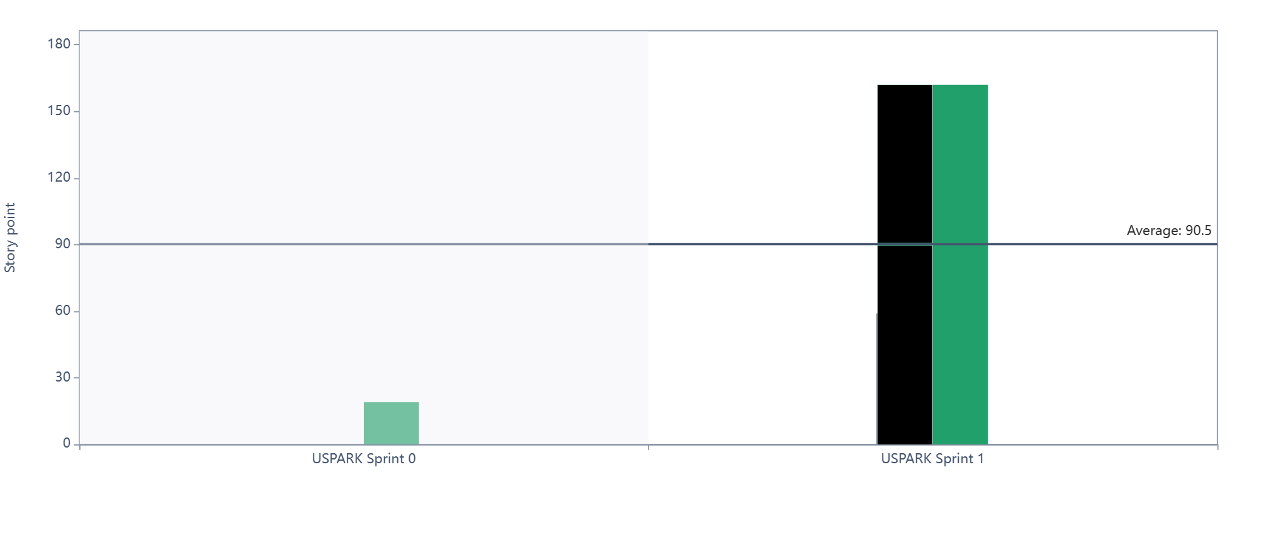
Sprint Velocity:
Committed
Completed

Slide 36
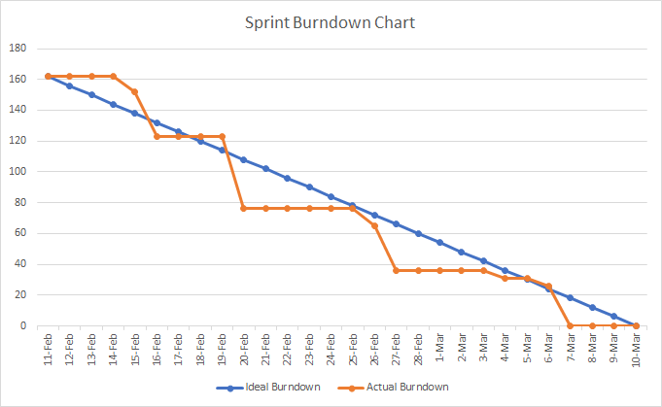
METRICS - BURNDOWN CHART

Slide 37
METRICS - COMMITTED RATIO

Slide 38
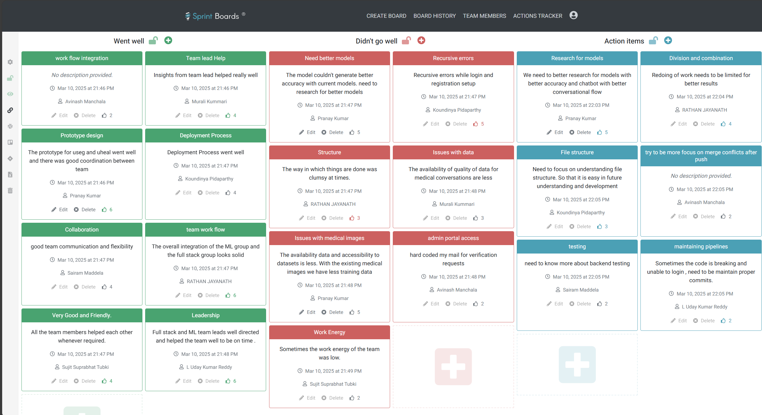
Sprint Retrospective:

Slide 39
Sprint 2 Planning:
S.NO | USER STORIES | ACCEPTANCE CRITERIA | FEATURE | STORY POINTS
US_2 | As a patient, I want to reset my password in case I forget it. | Given a patient clicks on "Forgot Password," when they enter a registered email or phone, then they should receive a reset link or OTP. | Password reset functionality | 2
US_5 | As a patient, I want to store my past medical assessments and reports for future reference. | Given a patient uploads a report, when the file is successfully processed, then it should be saved securely | Upload & store medical assessments and reports | 3
US_7 | As a patient, I want to schedule an appointment with a doctor based on available time slots. | Given a patient search for a doctor, when they select a time slot and confirm, then the appointment should be booked. | Appointment scheduling via Uheal. | 2
US_8 | As a patient, I want to choose between virtual or in-person appointments. | Given a patient is booking an appointment, when they select "Virtual" or "In-Person," then the system should confirm their choice. | Choose virtual or in-person consultation via Uheal. | 3
US_9 | As a patient, I want to receive appointment confirmation via email or SMS. | Given a patient books an appointment, when it is confirmed, then they should receive an email or SMS notification. | Appointment confirmation via email/SMS via Uheal. | 2
US_10 | As a patient, I want to reschedule or cancel an appointment. | Given a patient has an appointment, when they request to reschedule or cancel, then the system should update accordingly. | Reschedule or cancel appointments via Uheal. | 1

Slide 40
US_13 | As a patient, I want to receive a preliminary diagnosis from application based on my symptoms. | Given a patient interacts with the chatbot, when they provide symptoms, then the chatbot should generate a preliminary diagnosis. | AI-based preliminary diagnosis via Uheal. | 3
US_16 | As a patient, I want recommend doctors based on my condition. | Given a patient provides symptoms, when AI processes the data, then it should recommend the best doctor. | AI doctor recommendations based on condition. | 1
US_19 | As a doctor, I want to manage my profile, including my specialty, availability, and appointment preferences. | Given a doctor logs in, when they update their specialty, availability, or preferences, then the changes should be saved. | Doctor profile management | 2
US_20 | As a doctor, I want to see a list of my upcoming and past appointments. | Given a doctor is on the dashboard, when they check "Appointments," then they should see scheduled consultations. | Appointment Scheduling | 2
US_21 | As a doctor, I want to upload medical images (X-rays, MRIs, CT scans) for AI processing. | Given a doctor uploads an image, when AI processes it, then results should be displayed. | Upload medical images (X-rays, MRIs, CT scans) for AI processing via Useg. | 5
US_24 | As a doctor, I want to receive notifications when a patient books or cancels an appointment. | Given a patient books or cancels, when the status changes, then the doctor should receive a notification. | Receive notifications for appointments | 1

Slide 41
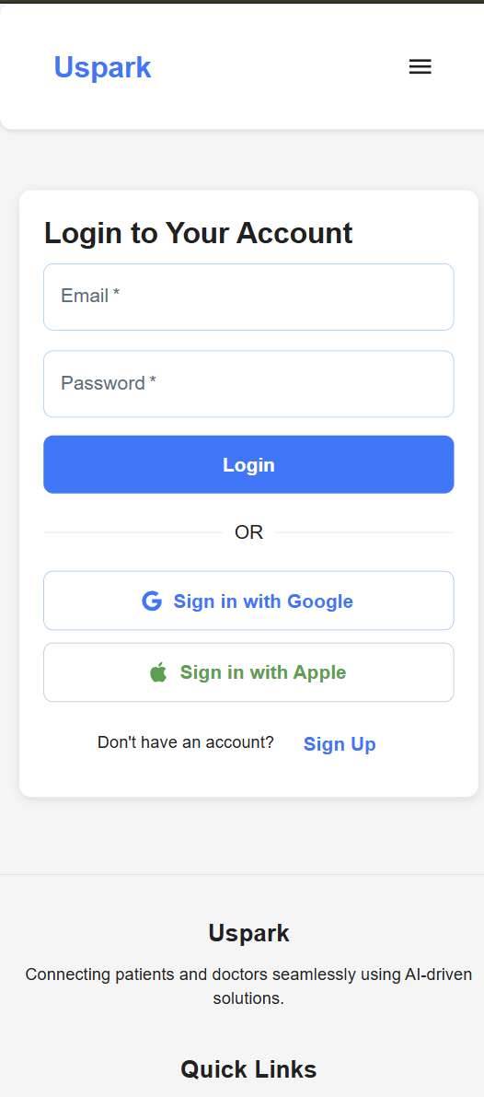
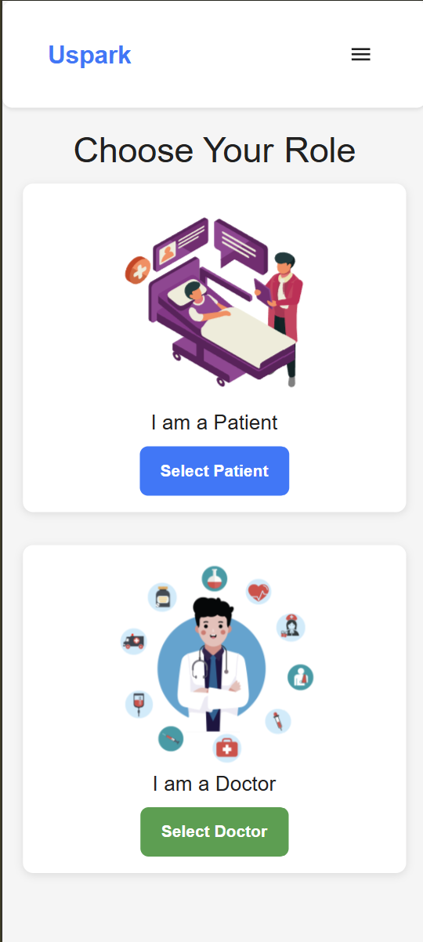
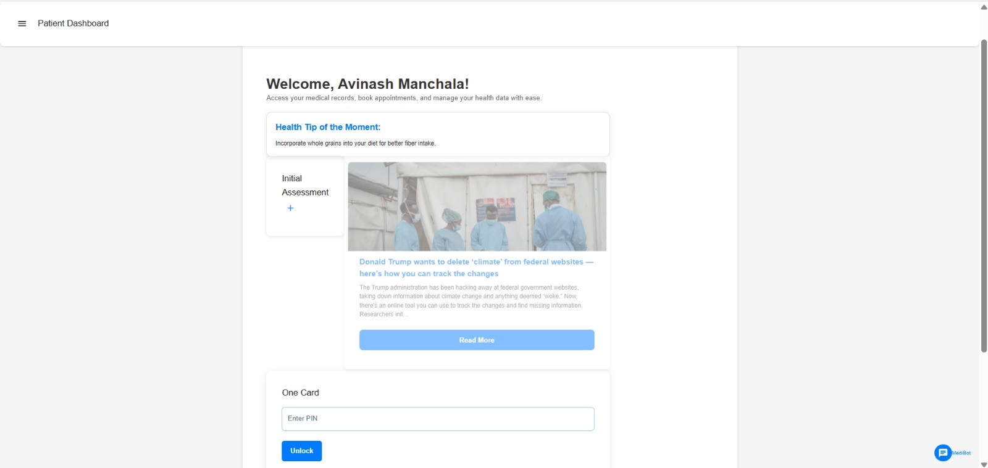
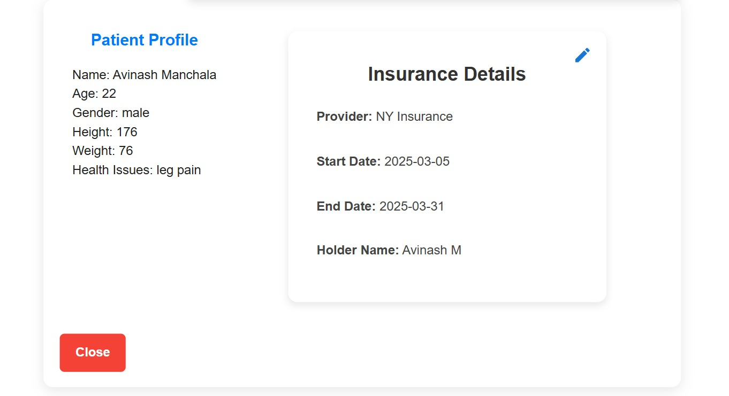
Project Demo

Slide 42
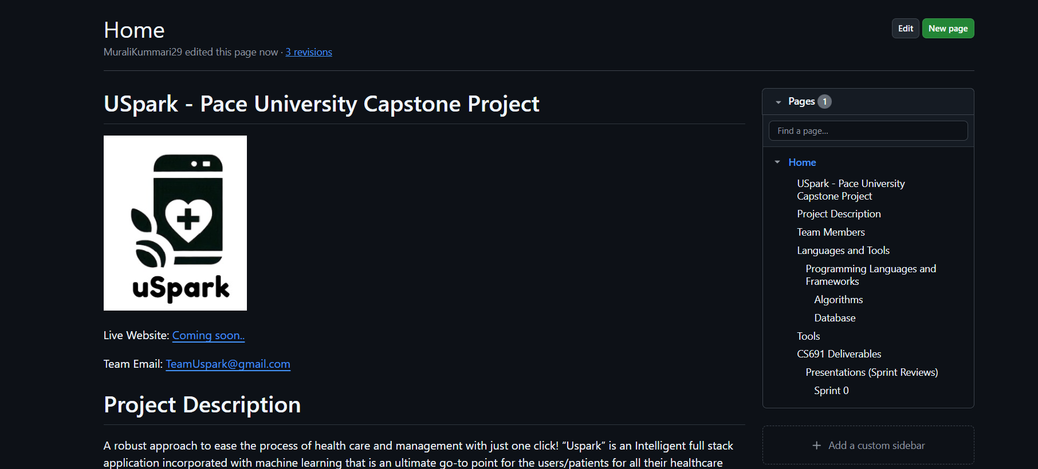
WIKI PAGE
https://github.com/htmw/2025S-RushHour/wiki

Slide 43
THANK YOU
CONTACT US:
teamuspark@gmail.com

